Slide 1

Devoir 2
Vérification et Validation en Modélisation Numérique
MMS
David Vidal
S. Paquette-Greenbaum, R. Zachariah, & K. A. N. Lippert
February 12nd 2024
https://github.com/karolali22/MEC8211_PROJECT

Slide 2
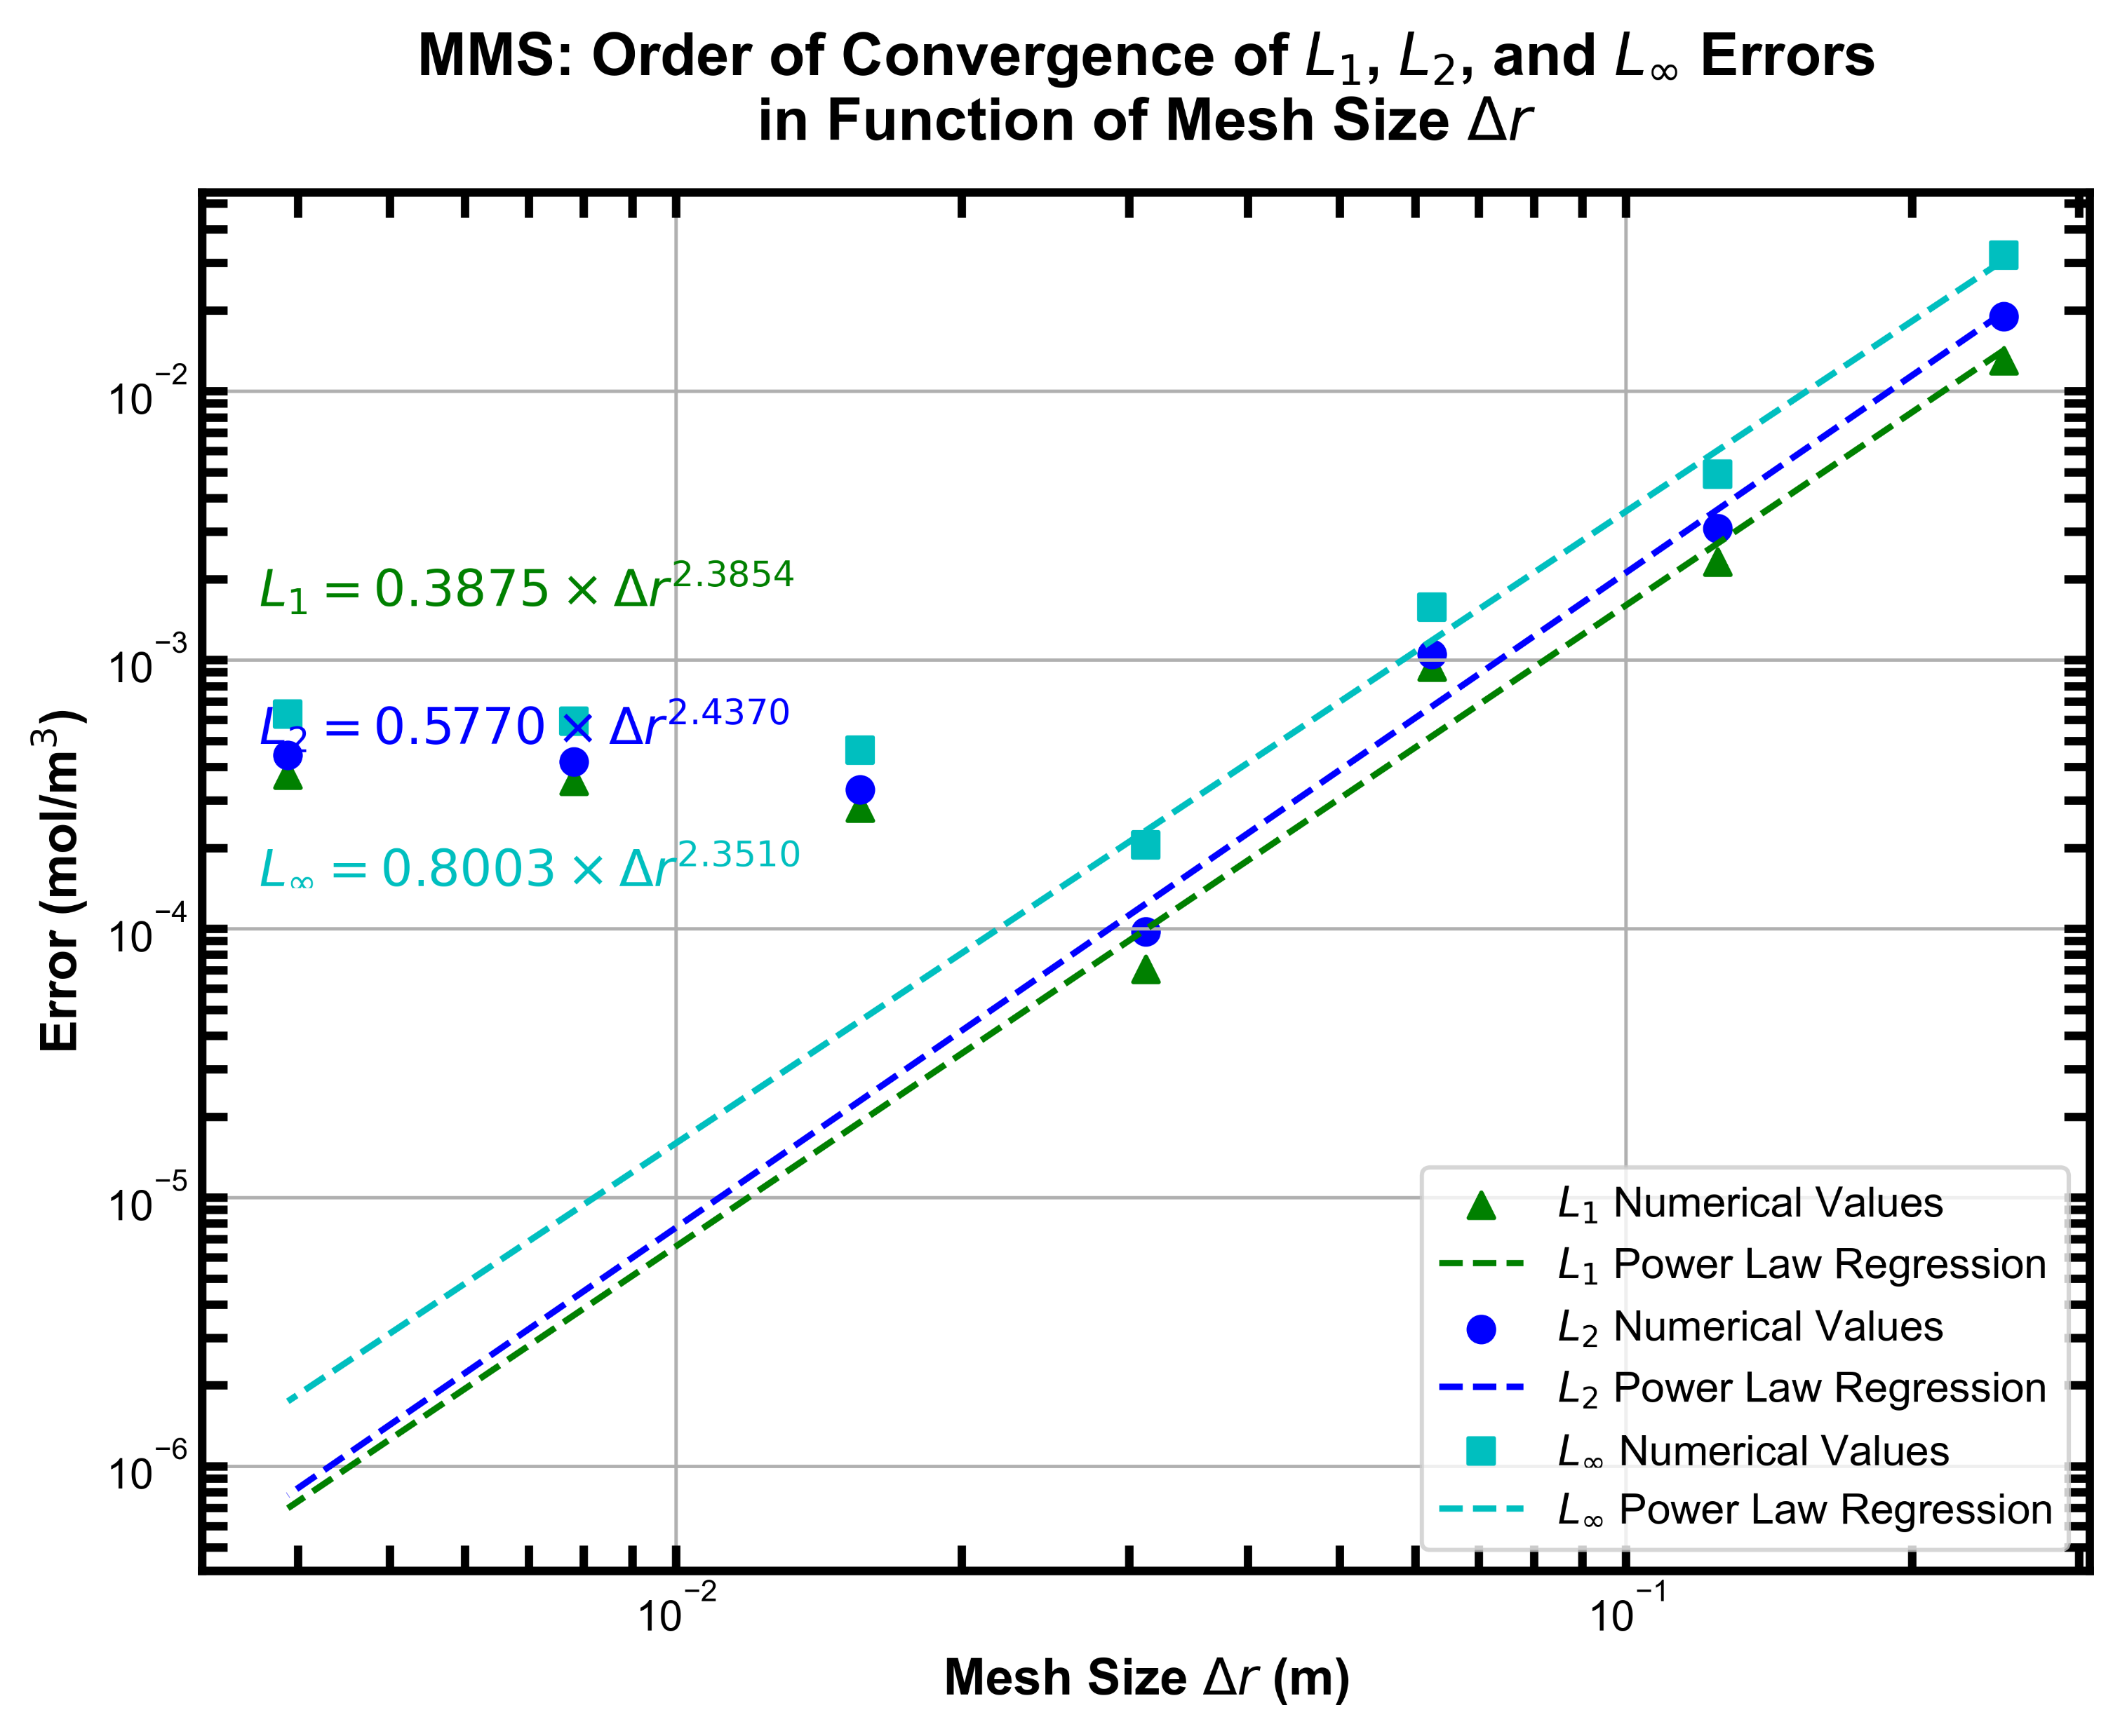
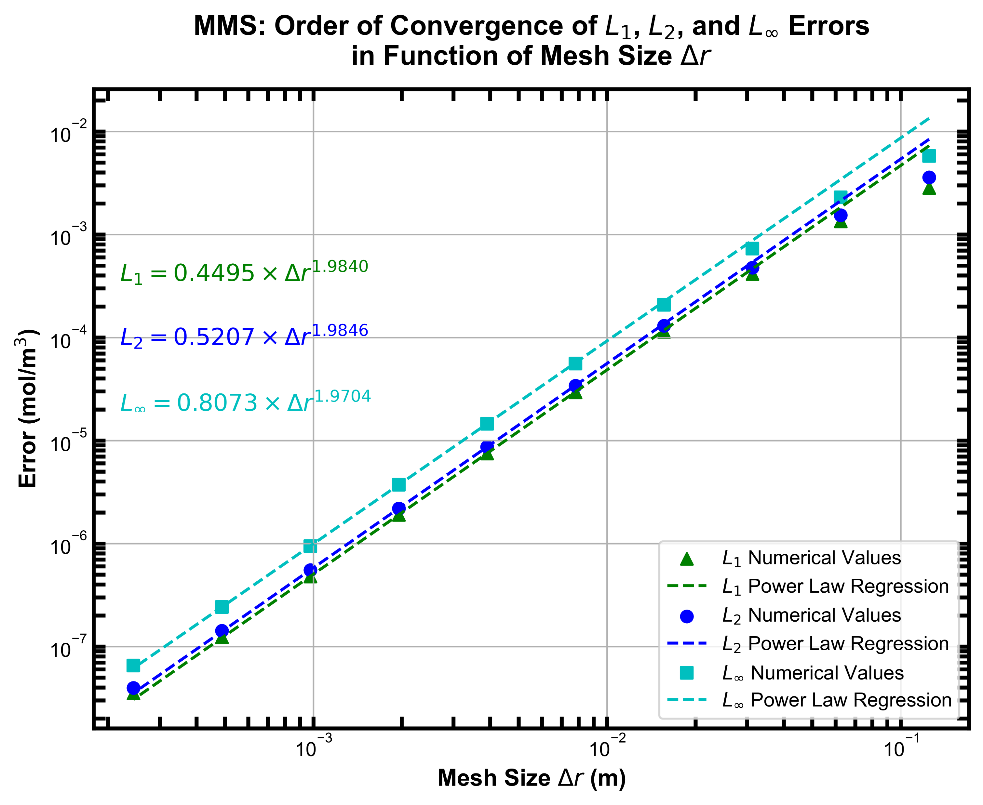

DISCLAIMER
The code was not found to converge past a certain accuracy threshold if the coefficients of diffusion and reaction were of a similar scale. We acknowledge that this signifies the existence of an error in the implementation of the code. For reasons relating to time constraints, the code verification study was conducted with D = 10⁻² & k = 4 x 10⁻⁹.
D = 10⁻² & k = 4 x 10⁻³
D = 10⁻² & k = 4 x 10⁻⁹

Slide 3
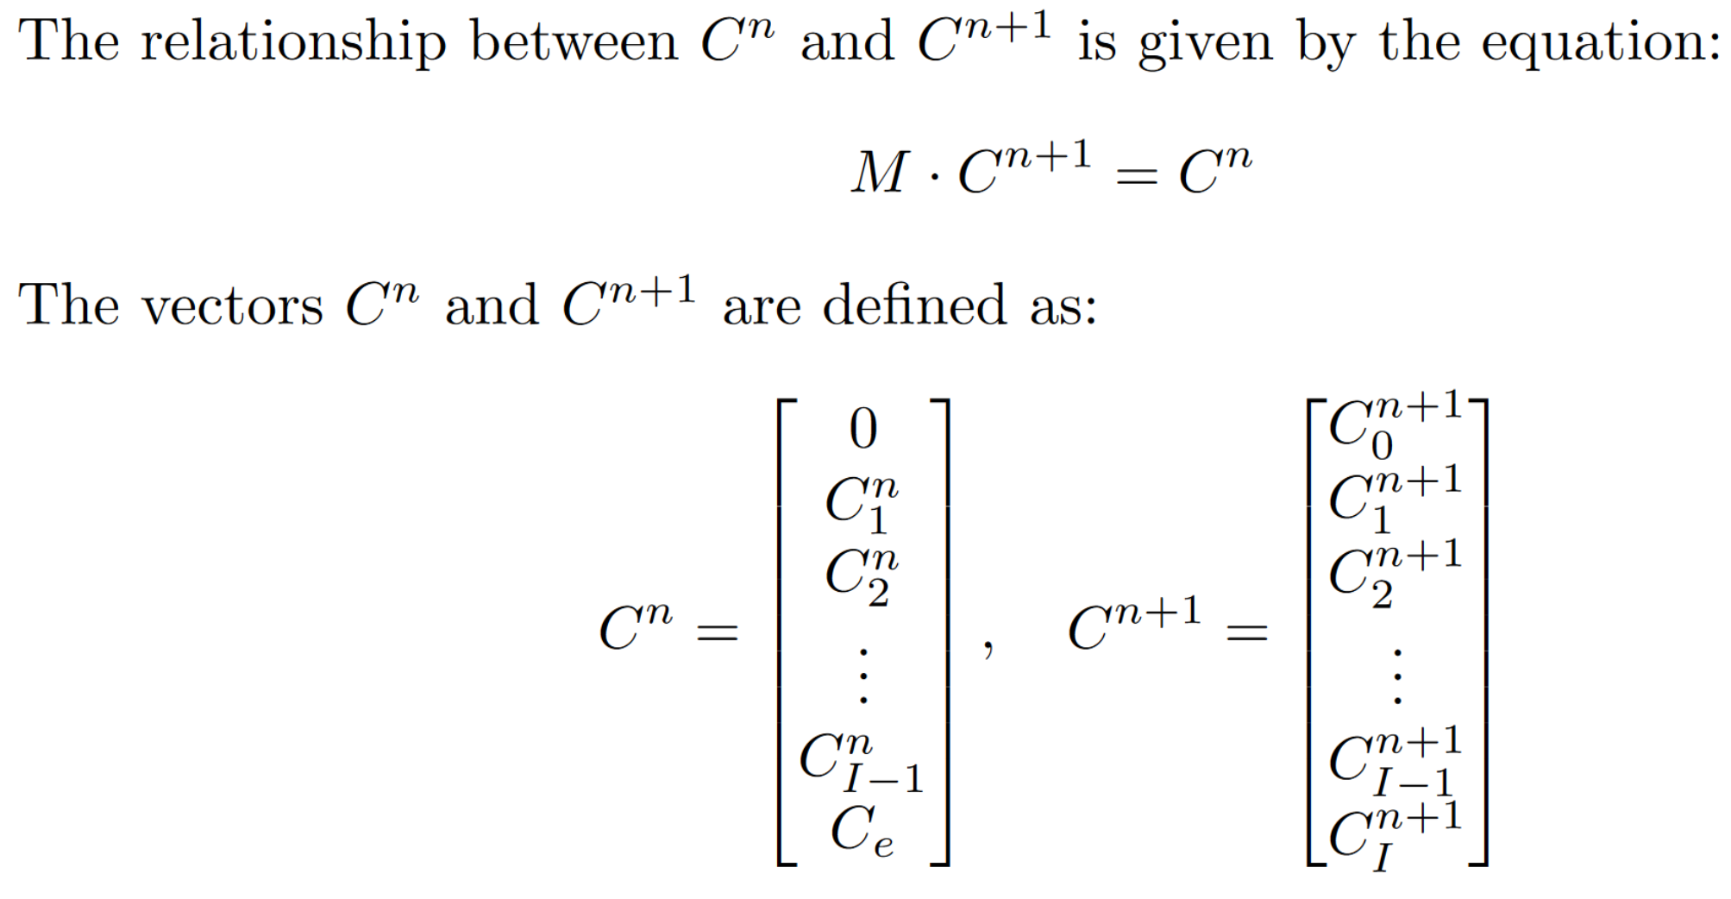
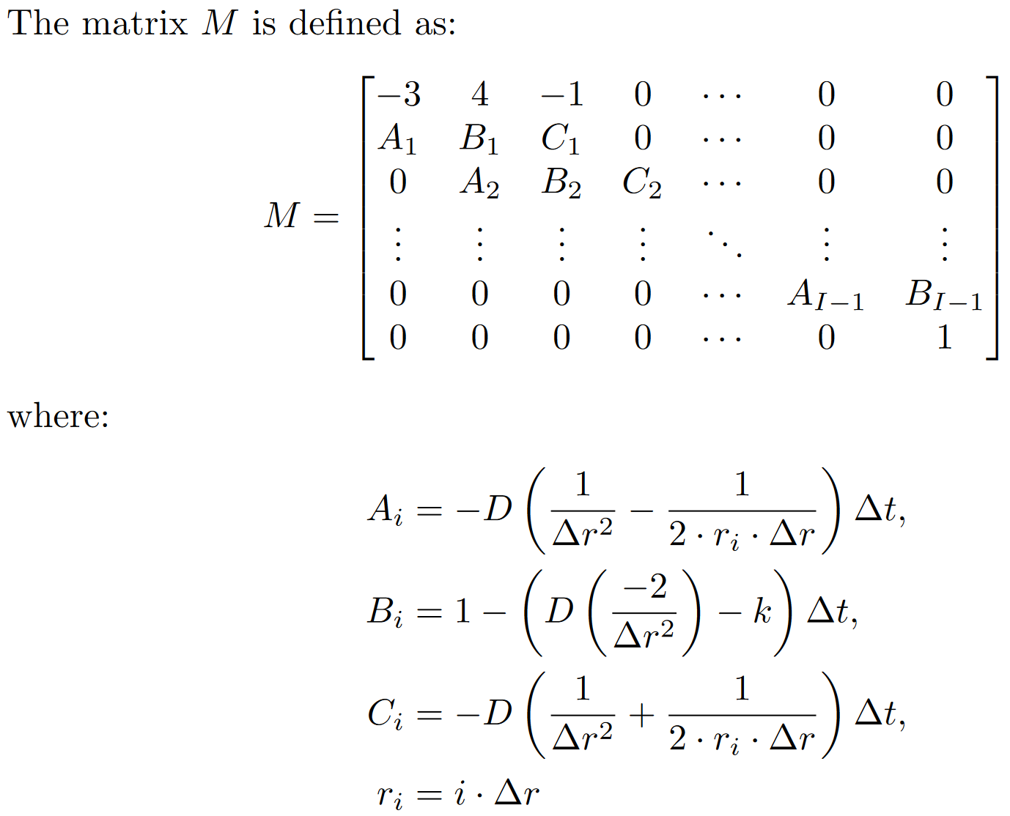
PDE IMPLEMENTATION – Polar 1-D heat equation with sink term

Slide 4
A. CONVERGENCE ANALYSIS – Method of Nearby Problems (MNP)
Detailed procedure chosen and methodology
The procedure chosen for generating a physically realistic manufactured solution is the Method of Nearby Problems (MNP).
The methodology used is listed below:
The pseudo-analytical solution is computed on a finely refined grid over a period of time. The concentration profile of each time step is saved for late use.
T = [0,10] s
dt = 1/1000 s
dr = 0.125/512 m
The solution space of the pseudo-analytical solution is retrieved through the use of a bivariate spline.
The pseudo-analytical source term can be found by evaluating the local temporal and spatial derivatives of the spline.
The source term is used in numerical simulations across grid refinement levels to evaluate the convergence order.
The error across numerical simulations is measured with respect to the spline which serves as the pseudo-analytical solution.

Slide 5

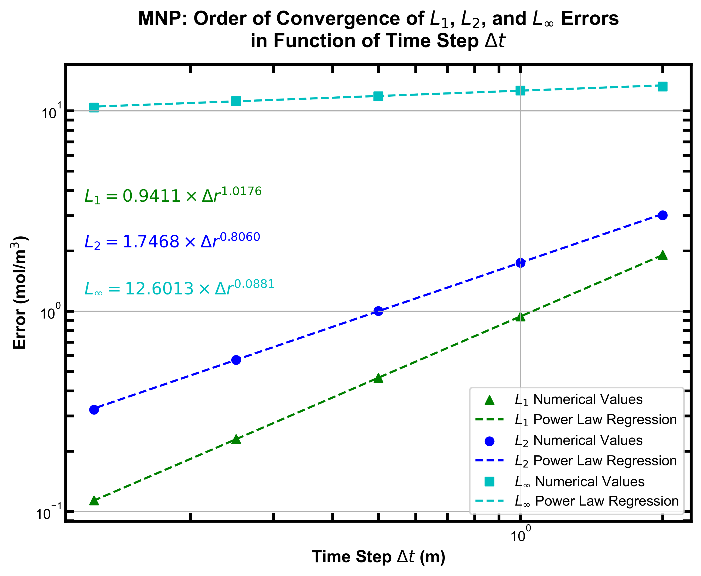
A. CONVERGENCE ANALYSIS – Method of Nearby Problems (MNP)
b. Results and observations
The temporal and spatial convergence analyses resulted in orders of convergence near what was expected, which respectively were a 1st and 2nd order convergence in time and space. The calculated orders of convergence did have a noticeable difference from the expected order of the numerical scheme. This can be attributed to the accuracy of the MNP analysis. The usage of a spline to map the solution space will inherently always bring some form of error. In this case, a 2nd degree bivariate spline was used. The temporal convergence analysis also depicts a very large L∞ error. Our assumption is that this large error came from the first few time steps. Conversely, the large L∞ error is not seen in the spatial convergence analysis as it was conducted much closer to the steady-state, where a 1-D polynomial fit of a nearby problem was used to determine the source term and pseudo-analytical solution.

Slide 6
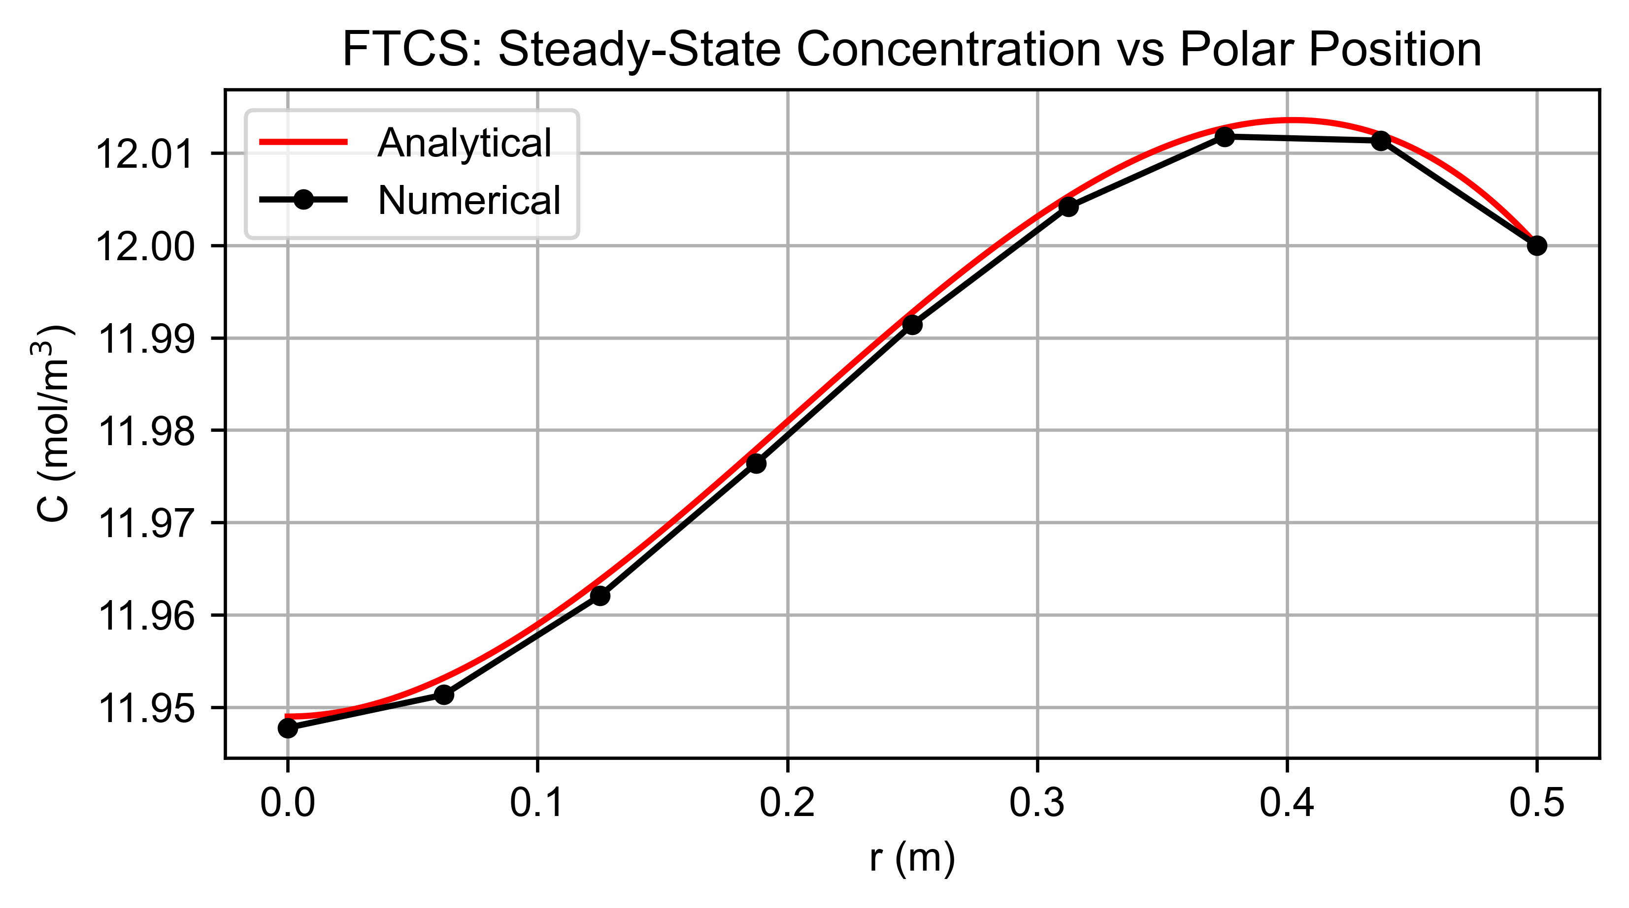
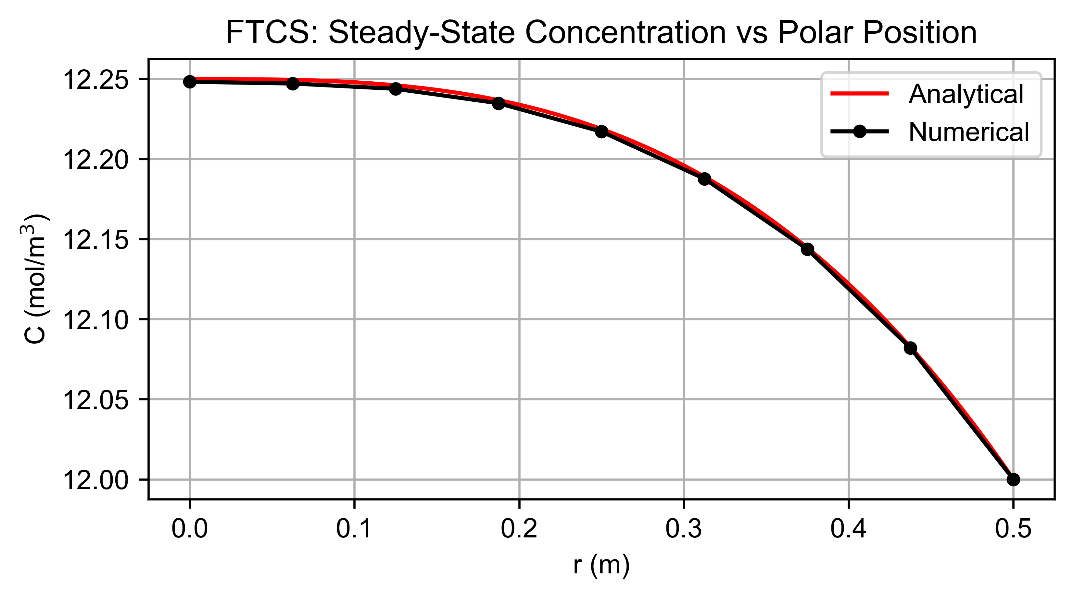
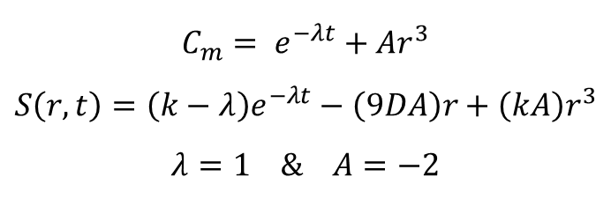
B. CONVERGENCE ANALYSIS – Method of Manufactured Solutions (MMS)
a. Manufactured solution
$$C_{m}= e^{−λt}+Ar^{3}$$
$$S\left(r,t\right)=\left(k−λ\right)e^{−λt}−\left(9DA\right)r+\left(kA\right)r^{3}$$
$$λ=1 \& A=−2$$
D = 10⁻² & k = 4 x 10⁻³
D = 10⁻² & k = 4 x 10⁻⁹

Slide 7


B. CONVERGENCE ANALYSIS – Method of Manufactured Solutions (MMS)
b. Analytical solution with boundary conditions applied
$$\frac{∂C}{∂t}=D\left[\frac{∂^{2}C}{∂r^{2}}+ \frac{1}{r}\frac{∂C}{∂r}\right]−kC$$
$C_{m}= e^{−λt}+Ar^{3}$ (Manufactured solution)
$$\frac{∂C_{m}}{∂t}=−λe^{−λt}\text{ ; }\frac{∂Cm}{∂r}=3Ar^{2} ; \frac{∂^{2}C}{∂r^{2}}\text{=}6Ar$$
$$\frac{∂C_{m}}{∂t}=D\left[\frac{∂^{2}C_{m}}{∂r^{2}}+ \frac{1}{r}\frac{∂C_{m}}{∂r}\right]−kC_{m}+S\left(r,t\right)$$
$$S\left(r,t\right)= −λe^{−λt}−D\left[6Ar+\frac{1}{r}\left(3Ar^{2}\right)\right]+k\left(e^{−λt}\text{ + }{Ar}^{3}\right)$$
$$S\left(r,t\right)=\left(k−λ\right)e^{−λt}−\left(9DA\right)r+\left(kA\right)r^{3}$$
$$S\left(r\right)=−\left(9DA\right)r+(KA)r^{3} \text{(}\text{Source} \text{term} \text{at} \text{steady} \text{state}\text{)}$$
$$0=D\left[\frac{1}{r}\frac{d}{dr}\left(r\frac{dC_{m}}{dr}\right)\right]−kC_{m}−\left(9DA\right)r+\left(kA\right)r^{3}$$
$0=DC_{m}−kC_{m}\frac{r^{2}}{4}−9DA\frac{r^{3}}{9}+kA\frac{r^{5}}{25}+β1\ln\left(r\right)+β2$ (where $β1$ and $β2$are integration constants)
Applying Boundary Conditions
$$As{ C}_{m}=C_{e} at r=R;$$
$$β2=kC_{e}\frac{R^{2}}{4}−DC_{e}+\left(9DA\right)\frac{R^{3}}{9}−\left(kA\right)\frac{R^{5}}{25}$$
$$β2=C_{e}\left(\frac{kR^{2}}{4}−D\right)+AR^{3}\left(D−\frac{kR^{2}}{25}\right)$$
$$0=C_{m}\left(D−\frac{kr^{2}}{4}\right)−Ar^{3}\left(D−\frac{kr^{2}}{25}\right)+β2$$
$$C_{m}= \frac{1}{D−\frac{kr^{2}}{4}}(Ar^{3}\left(D−\frac{kr^{2}}{25}\right)−β2)$$

Slide 8
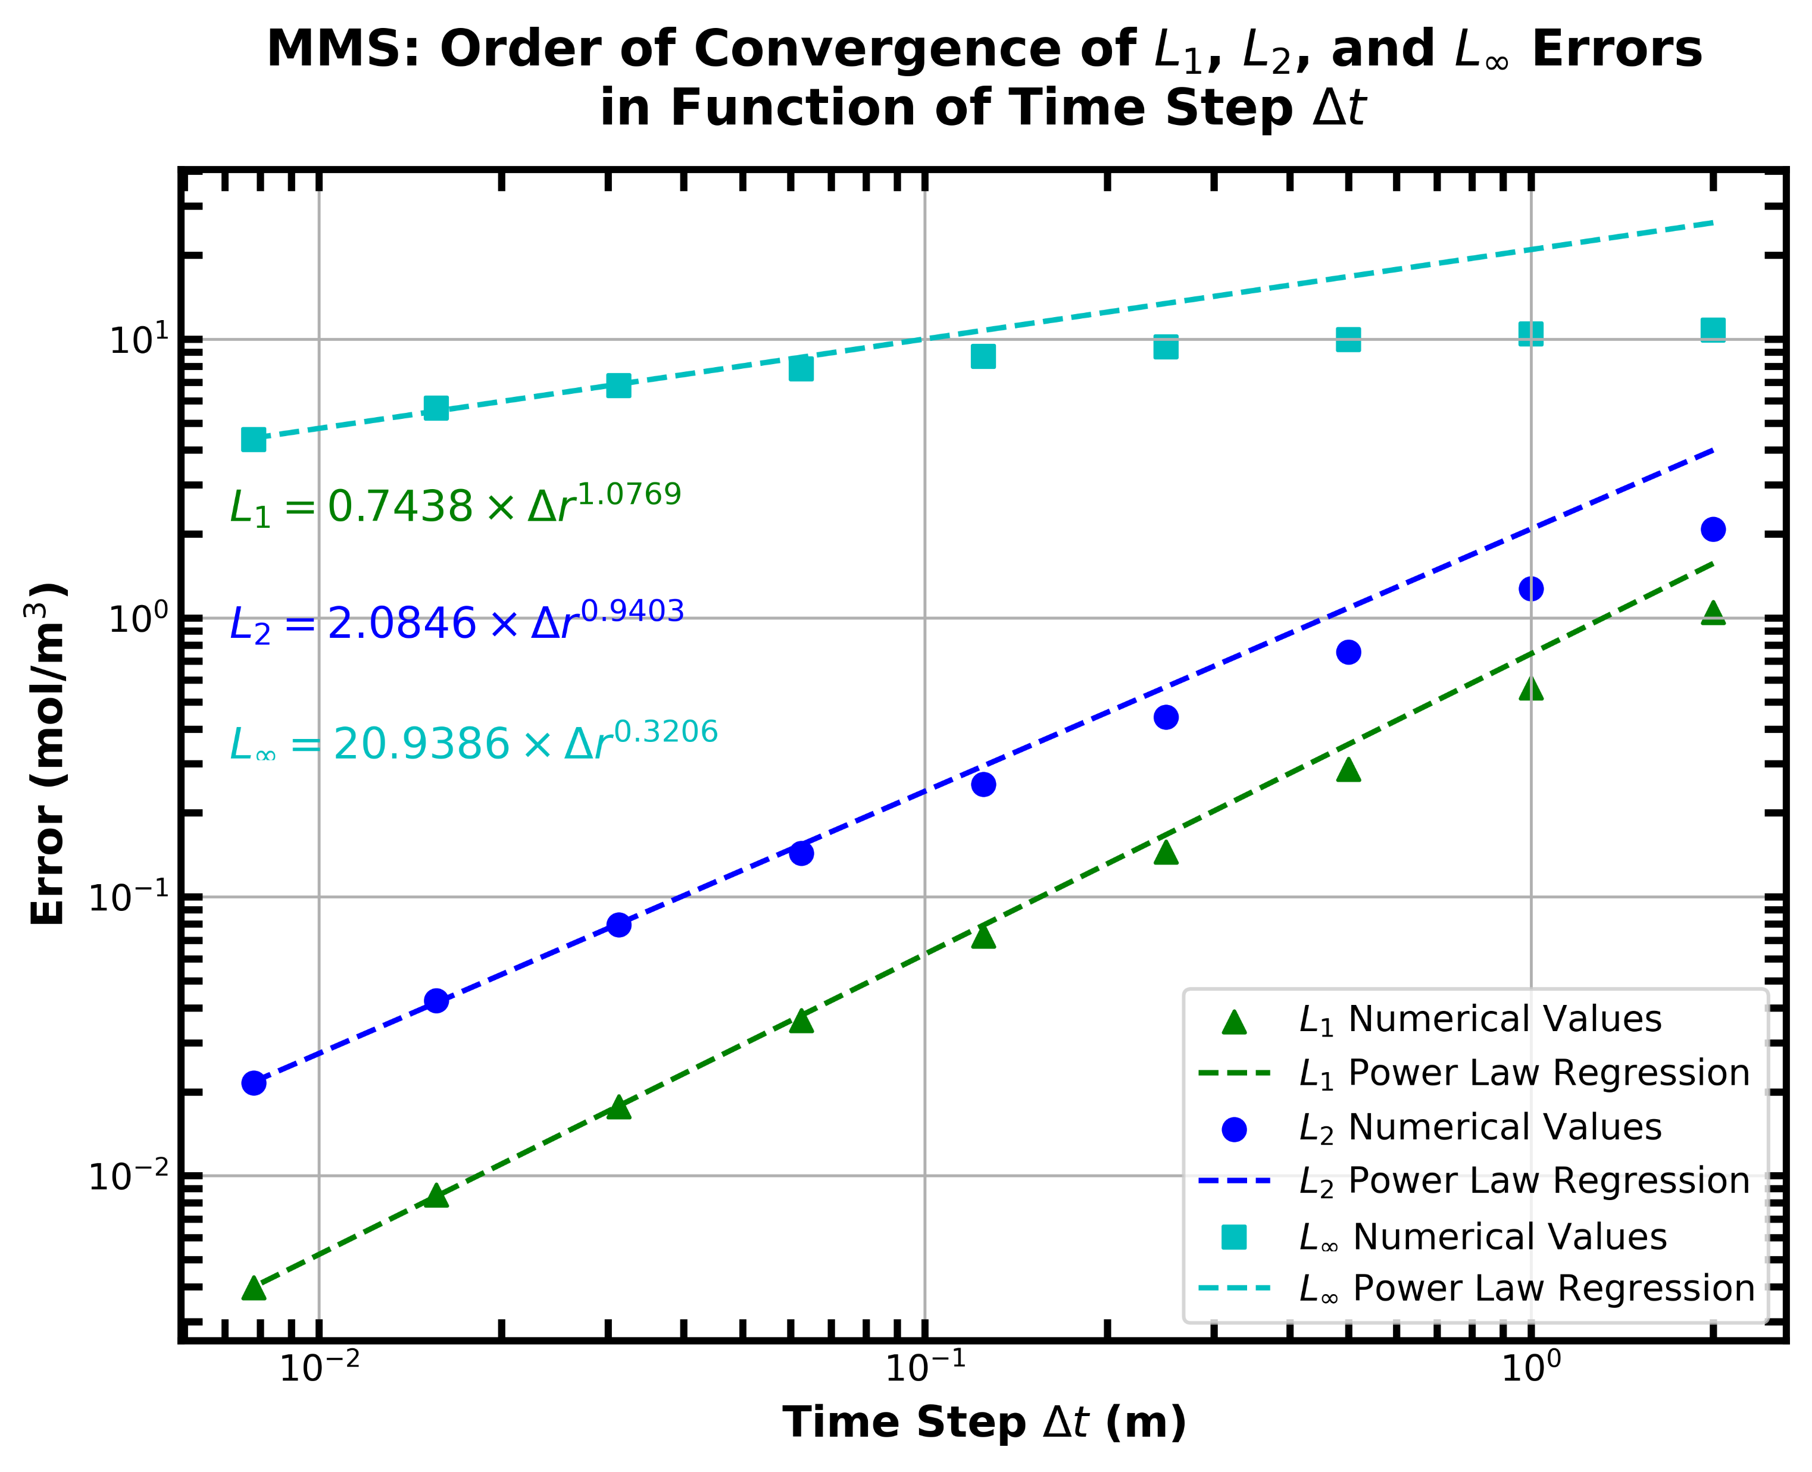
B. CONVERGENCE ANALYSIS – Method of Manufactured Solutions (MMS)
c. Results and observations
The temporal and spatial convergence analyses resulted in orders of convergence very close to what was expected, which respectively were a 1st and 2nd order convergence in time and space. There exists a small noticeable difference between the expected temporal order of the numerical scheme and the order measured in the convergence analysis. This can be attributed to the accuracy of the method through which temporal error was computed. The 2-D solution space was mapped on a 2nd degree bivariate spline to simplify the process of error computation. We acknowledge that the use of a more rigorous method could have led to smaller measured temporal errors. Conversely, the spatial order of convergence falls within ±1% of the numerical scheme’s spatial order. The spatial convergence analysis does not suffer from the same issue as the temporal analysis as the steady-state analytical solution was used as the reference for error computation.

Slide 9
C. CONCLUSION
Comparison between MMS & MNP
It can be concluded that both the MMS and MNP have their benefits and drawbacks.
The MMS is certainly more precise as it does not rely on some form of numerical interpolation to compute the analytical solution and necessary source term.
For the same reason as stated above, the MMS is also less computationally complex and requires less resources.
While being less precise and requiring more computational resources, the MNP has the advantage of being applicable to problems too complex to derive the source term analytically as one would do with the MMS.
With respect to the MNP convergence analysis, the orders of convergence measured with the MMS were significantly closer to the temporal and spatial orders of the numerical scheme. While not measured, the computational time required for the convergence analyses was much larger with the MNP than for the MMS.
Given that a scripting/coding framework for conducting these analyses is already completed, it would be much easier to conduct the MNP on a new problem as the computation of the source term with this method is trivial.

Slide 10

THANK YOU!

